Slide 1

Digital Assistant for Vehicle Drivers
Presented By
Md Tasnimul Khair Tousif (1607015)
Md Rahat Ebne Alamgir Porosh (1607047)
Supervised By
Dola Das Mam
Lecturer
Department of Computer Science and Engineering
KUET

Slide 2
Introduction
Digital assistant alternatively referred to as virtual assistant is a computer program or software agent that is designed to help a user to automate his/her daily tasks and performs question-answer based approach to help him/her.
Most prominent examples of digital assistants are Alexa, Google Voice assistant, Mycroft, Chris etc.
This concept can be applied to vehicle drivers. This project primarily aims to automate some simple tasks to help vehicle drivers. It can also help the vehicle owners to keep track of their vehicles by means of mobile and send various status of vehicles.
Vehicle based digital assistants are fairly old concept, some functioning examples are Chris , Alexa, Mycroft etc.
OutlinIn

Slide 3
Problem Statement
Many people in our country has cars or other vehicles. Some use that for their own transportation. And some hire others to use these vehicles as passenger transportation system , earn money from the vehicles and consider them as an investment. But most of the vehicles can play just music and has no smart features.
The hired person can lend the vehicle to others and earn money that will not reach to the owner and the owner will be in the dark since he cannot know who is driving his vehicle. Again the driver can tell lower number of the passengers and keep some money for himself. So a system is needed so the owner can be sure his hired driver is driving the vehicle
The driver can find the need to go to a place whose way he doesn’t know. This software can provide the navigation function. So navigation guidance is needed.
The driver can get sleepy. Drowsiness can cause major accident. So a system that can detect the driver’s drowsiness can save a lot of lives.

Slide 4
Objective
To help with anti theft of vehicles
To help the driver keep awake
To help the owner keep track of his vehicles
To provide driver with latest news
To answer queries of the driver
To navigate the driver in unknown locations

Slide 5
Contribution
Many digital assistant based work has been done before. But they are focused as personal assistant. Digital assistant optimized for vehicles has made like Chris. But it is not open sourced and studies have not yet been done much.
The drowsiness detection scheme is based on the Soukupova ‘s paper on detecting sleep status by eye aspect ratio. Other works were done independently.
Many code blocks includes use of existing modules and libraries to prevent reinventing the wheel.

Slide 6
Proposed Methodology: Modules and Libraries
Instead of implementing all the features from the bottom, the project utilizes some existing modules and libraries that handles those tasks gracefully.
OpenCV: To implement image processing features.
Firebase: To implement data sending to server.
Google Speech Recognition: For recognizing user’s speech to turn it into appropriate command.
Pyttsx3: Python text to speech module.
threading, signal: For concurrent execution of methods.
Dlib: Facial landmarks.
Imutils: Facial landmarks detection.
Scipy, Numpy: Computer vision related functions.

Slide 7
Proposed Methodology: Modules and Libraries Contd.
Webbrowser: Automation of web browsing.
Face_recognition: Recognition of driver’s face, count number of passengers based on faces.
Android studio: To build a simple app to display vehicle location to the owner.
Scrapy: For web crawling
Os: To run command line

Slide 8
Proposed Methodology: Input and Output
Google speech recognition is used for voice based input command. Google Cloud Speech-to-Text enables developers to convert audio to text by applying powerful neural network models in an easy-to-use API. The API recognizes 120 languages and variants to support your global user base. You can enable voice command-and-control, transcribe audio from call centers, and more. It can process real-time streaming or prerecorded audio, using Google’s machine learning technology. It captures audio and recognizes speech and turns it to text-based input which are feed into software. It is instantiated when the project starts and runs till the end. A get_audio() method utilizes Google speech recognition to take input.
Python text to speech module is used for voice output. Python text to speech or pyttsx is a Python package supporting common text-to-speech engines on Mac OS X, Windows, and Linux. A speak() method uses this module.
Voice based input and output is used to minimize distraction

Slide 9
Proposed Methodology: Query Searching, Web Browsing, Navigation
At first the user will say find to the voice input
Then the program will go to search mode
The user now can search his query with voice
The search() method will be called
The user can ask the query and the query will be searched in google.com and the result will open in the default browser
The user can say “go to site.com” and the site specified after “go to” will open in the browser
The user can say “navigate to place name” and the navigation to the place will open in the browser
The user can say “exit” to close the search mode

Slide 10
Proposed Methodology: News Crawling
The user can get latest news necessary to him. He can get four types of news. They are:
Tech News
World News
Cricket News
Football News
The latest news headlined are scraped from 4 sites each supplying different types of news. The web crawling and scraping is done through spiders that are created by using the scrapy module. The news are displayed after being crawled from the websites. The news are also read aloud so that the driver does not look away from the road.

Slide 11
Features
Face recognition to identify the driver
Face count so that the owner can know number of passengers
Location tracking to provide the owner the locations of the vehicles
Sleep detection which alarms the driver if he is about to doze off
Web crawling to provide the driver with latest news
Web search to answer query of the driver
Web navigation to help the driver reach his destination
Voice input and output to facilitate hands free operation

Slide 12
Basic Users
It is mainly for two types of people. They are:
Drivers: They will use mainly the information and sleep detection features. They can also use location tracking and face recognition in case of a theft. These features will help them to find their vehicles easier
Vehicle owners: These are the persons who hires people to drive their vehicles as passenger transport and earns money by doing so. They can use the face recognition feature to identify the driver and location tracking to know the whereabouts of their vehicles. They will also know the number of passengers so that the driver cannot cheat money.

Slide 13
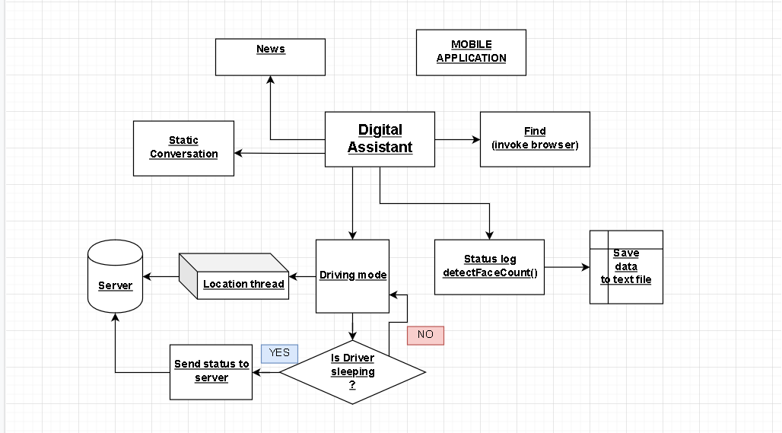
Project Flowchart
Figure 1: Process flowchart

Slide 14
Query Search
At first the user will say find to the voice input
Then the program will go to search mode
The user now can search his query with voice
The browser will open automatically with the result of query search
The user can quit search mode by saying exit

Slide 15
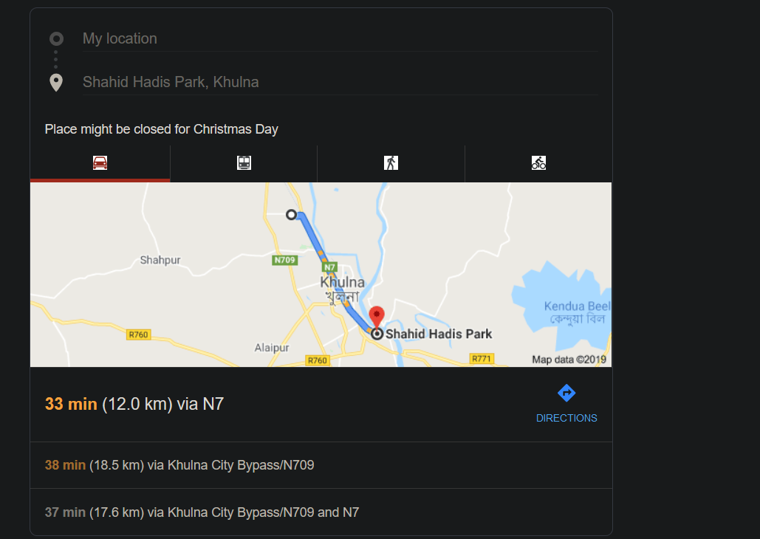
Query Search: Continued
Figure 2: location Search

Slide 16
News
When the user says news an option of four types of news appear. The user can select the type of news that he needs. The four types of news are:
Tech News
World News
Cricket News
Football News
The news are provided by scraping headlines of sites related to the news. After scraping the news from the sites they are shown in the screen and are also said by the assistant. For scraping the sites scrapy module is used. For saying the news out loud speak() method is called. The method utilizes pyttsx.

Slide 17
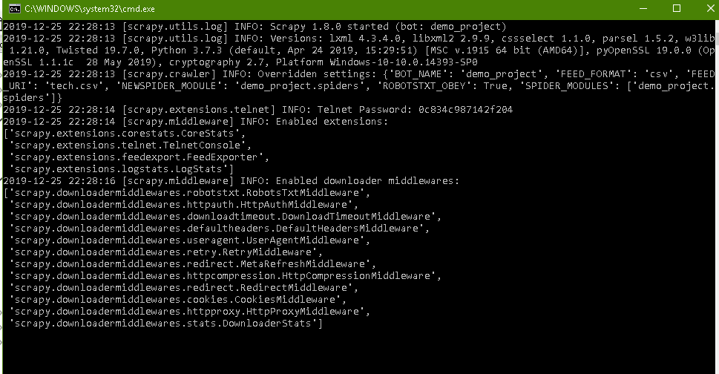
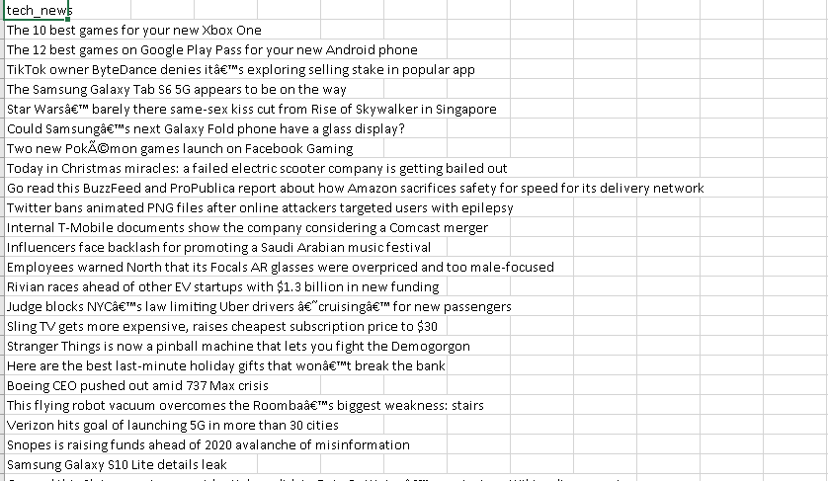
News: Continued
Figure 3: News by web crawling

Slide 18
Face Recognition
The face detection feature is used to verify vehicle drivers.
First an image is captured, then it is loaded and passed through compare_faces() method of the face recognition module. It matches captured face with the stored faces who are the registered drivers.
It tells the owner which driver is driving the car and make sure that unknown person are not one of them.

Slide 19
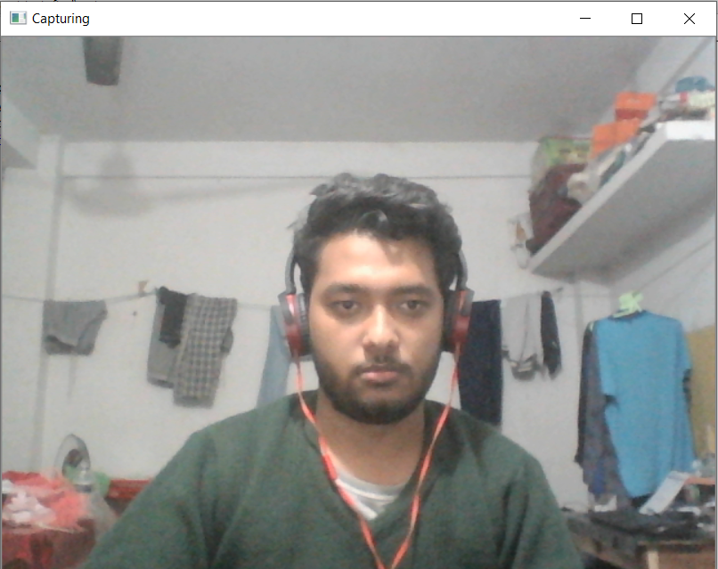
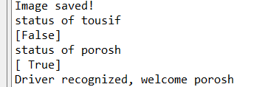
Face Recognition: Continued
Figure 4: Face recognition

Slide 20
Face Counting
The face counting is done to know how many passengers are in the car. This also captures an image from the camera and then it is loaded inside the application. The modules face_locations(image) method finds the number of faces by returning a list of dlib 'rect' objects of found face locations. It’s length is face count.

Slide 21
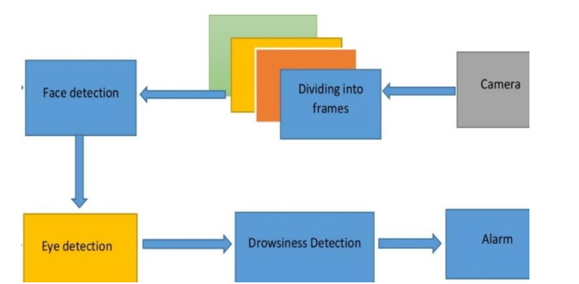
Drowsiness detection
1. Setup a camera that monitors a stream for faces.
2. Next, if a face is found, we apply facial landmark detection
and extract the eye regions.
3. Then, now that we have the eye regions, we can
compute the EAR(0.3) to determine if the eyes are closed.
Finally, if EAR indicates that the eyes
have been closed for a sufficiently long enough
amount of time(48 frame), we’ll sound an alarm
to wake up the driver.
Figure 5: Algorithm for drowsiness detection

Slide 22
Drowsiness detection continued
Facial landmarks are used to localize and represent salient regions of the face, such as: Eyes, Eyebrows, Nose, Mouth etc. Dlib has included a facial landmark detector. It includes –
1.A trained set of labeled facial land marks with 68 x, y coordinates to map the facial structures of the face.
2. Also priors, the probability of distance between two input pixels.
This allows us to detect regions correctly. These mappings are included in the imutils library used in the module, so explicit usage of these values are not required. The imultils framework has function called shape_to_np which The dlib face landmark detector will return a shape object containing the 68 (x, y)-coordinates of the facial landmark regions. Using the shape_to_np() function, it can be converted to to a NumPy array.

Slide 23
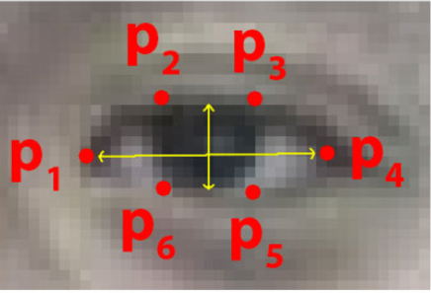
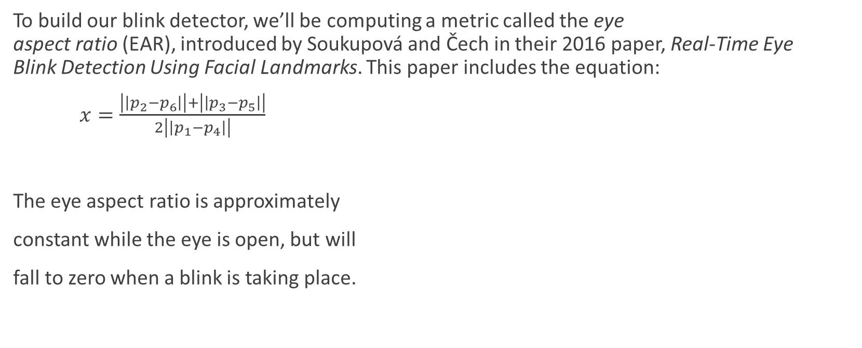
Drowsiness detection continued
To build our blink detector, we’ll be computing a metric called the eye aspect ratio (EAR), introduced by Soukupová and Čech in their 2016 paper, Real-Time Eye Blink Detection Using Facial Landmarks. This paper includes the equation:
$x=\frac{\left|\left|p_{2}−p_{6}\right|\right|+\left|\left|p_{3}−p_{5}\right|\right|}{2\left|\left|p_{1}−p_{4}\right|\right|}$
The eye aspect ratio is approximately
constant while the eye is open, but will
fall to zero when a blink is taking place.
Figure 6: The 6 facial landmarks associated with the eye

Slide 24
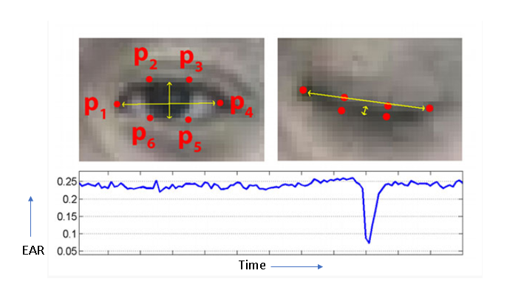
Drowsiness detection continued
Figure 7: If eye aspect ratio drops below or equal 0.3, a blink is indicated. Now if this state sustains for 48 consecutive frames, an alarm sound will be played to alert the driver.

Slide 25
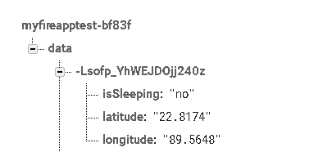
Location fetching and sending data to remote server
The location data was fetched from the website (/get.geojs.io). First ip of current laptop was obtained, then a new link was constructed with that ip and a request was formed. Finally a JSON file was fetched by this request.
The JSON file was parsed, the sleeping status was a included- thus the data packet was made. Then it was sent to firebase server real time storage by post method.
The location thread had to be running as long as the driver kept driving, so it was invoked by a separate daemon thread. It was killed when the main method was terminated.
Figure 8: Data sample of firebase real time database

Slide 26
Android Application
The application simply designed to fetch data objects from firebase real time database. Each data object has 3 attributes so a model class have been declared accordingly.
A list of data models is populated with fetched data. Then this list is passed to a custom adapter. This custom adapter is passed to a setAdapter method which shows the list view of data to the user.
Upon clicking on list, single item view is also available.

Slide 27
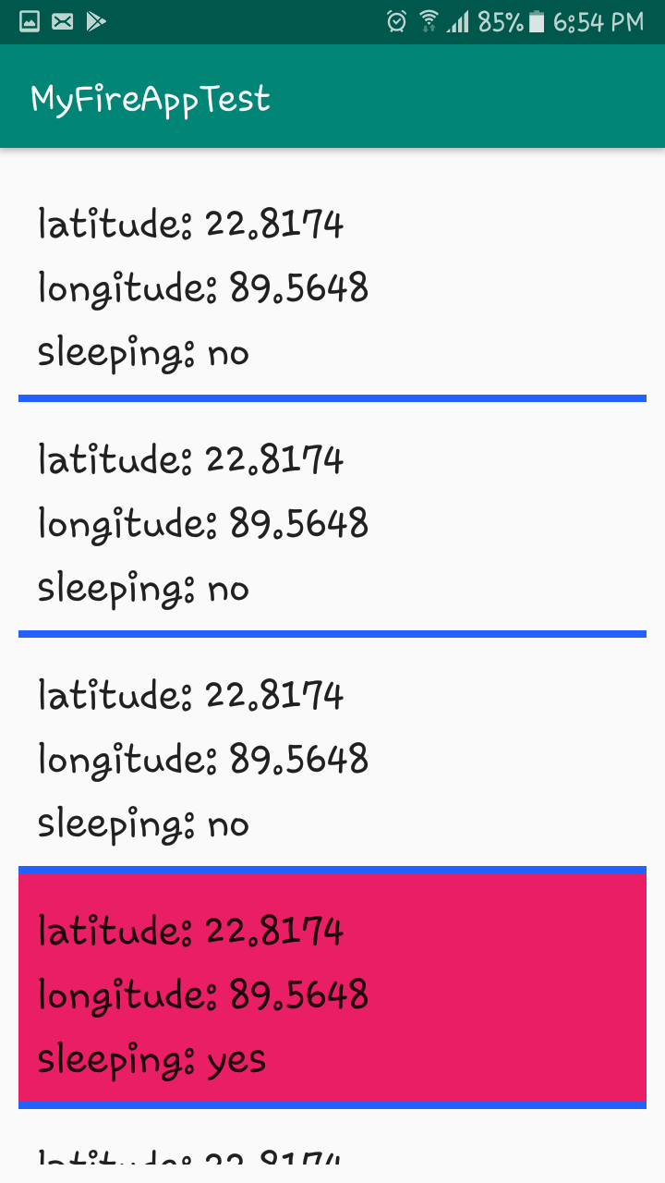
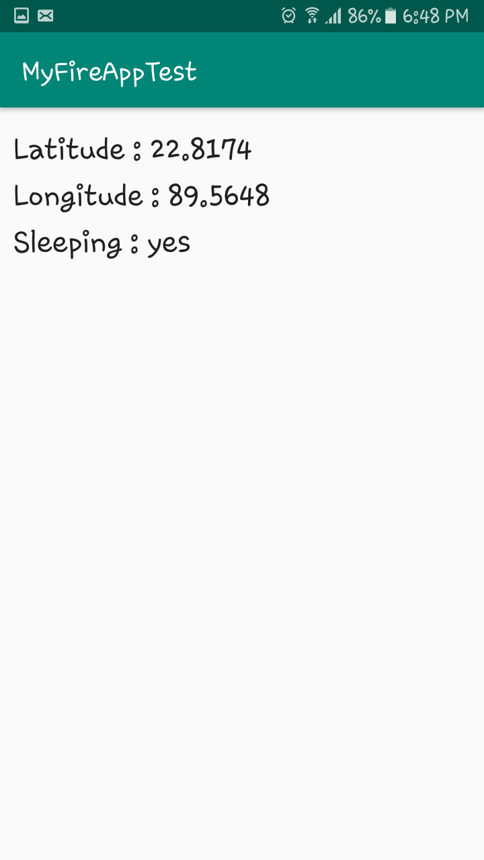
Android Application
asd
Figure 9: Demonstration of Android application

Slide 28
Limitations
The application is heavy, it takes 0.3% of CPU (core i5) while running location and sleep detection thread simultaneously. Also takes 46.3 Megabytes of RAM(DDR4) space all the time. If it is installed on a Raspberry pi (1.5 GHz 64-bit quad-core ARM Cortex-A72 processor, with 1MB shared L2 cache), it will run much slower.
The face detection gives inconsistent performance in the low light.
The response time of voice detection, sleep detection method is really slow for real life cases. The drowsiness detection method takes 1.3 seconds to 1.5 seconds to response, but in slower machine it takes 3.5 to 5 seconds. The speech recognition freezes due to slow internet speed.
The UI of Android application is not up to the mark.
Due to noise in a video stream, subpar facial landmark detections, or fast changes in viewing angle, a simple threshold on the eye aspect ratio could produce a false-positive detection.
Use of key pressing could not be eliminated entirely.

Slide 29
Future improvements
Make the blink detector method more robust. Instead of dlib 68-point facial landmarks (top) we can use the 5-point facial landmarks detector.
Make the application lightweight enough to port it to critical resourced computing devices like raspberry pi or other devices.
Make a voice enabled UI to eliminated the use of keystrokes.
Build a full fledge, well featured Android application.
Eliminate the use of Google speech recognition by using custom trained models like CMU-Sphinx.
IOT related features like turning off-on lights, car doors, car engine, self driving etc. can be incorporated. This will be like the “Brain of the Vehicle” at this stage.

Slide 30
Conclusion
The project was built to form scratch to demonstrate the use of digital assistant in the context of vehicle drivers. Though some of the features did not work well at all times, the results were quite satisfactory. By improving the project even further, it can be used in real life for drivers. The sleep detection method will serve greatly to reduce road accidents and the rest of the features are crucial for a smart car. By integrating the device and after some minor modifications, any car can become a smart car. This is the true potential of this project.

Slide 31
References
https://en.wikipedia.org/wiki/Virtual_assistant
https://en.wikipedia.org/wiki/Siri
https://en.wikipedia.org/wiki/Bixby_(virtual_assistant)
https://en.wikipedia.org/wiki/Google_Assistant
https://en.wikipedia.org/wiki/Amazon_Alexa
https://en.wikipedia.org/wiki/Interactive_voice_response#Developments
https://mycroft.ai/
https://jasperproject.github.io/
https://pypi.org/project/face_recognition/
https://dspace.cvut.cz/bitstream/handle/10467/64839/F3-DP-2016-Soukupova-Tereza-SOUKUPOVA_DP_2016.pdf
One Millisecond Face Alignment with an Ensemble of Regression Trees
http://blog.dlib.net/2014/08/real-time-face-pose-estimation.html
iBUG 300-W dataset
Histogram of Oriented Gradients + Linear SVM method
Real-Time Eye Blink Detection Using Facial Landmarks.
Associated courses:
Object Oriented Programming
Data Structures and Algorithm
Advanced Programming
Peripherals and Interfacing
Mobile Computing
Image Processing and Computer Vision

Slide 32
The End!
Thank you!

